Slide 1
Evaluation I
Dr Simon Lock
simon.lock@bristol.ac.uk

Slide 2
Overview
So you have deployed a release to your client ?
But how “good” is it ?
Your client might have given you a bit of feedback
But can you systematically evaluate your product ?

Slide 3
Conforms to specification ?
OK, so you are all doing test driven development
Tests define the required operation of the system
They are run against the code whenever you build
So your system is always “correct”
Surely that is enough ?

Slide 4
“Testing” versus “Evaluation”
A key distinction between the two:
Testing is the low-level process of checking that a system conforms to its specification
(does the system operate as developers intend ?)
Evaluation is the process of assessing higher-level, more subtle qualities of the system
(does the system operate to support users needs ?)

Slide 5
In pictures…
Verification
(Testing)
Actual Client Needs
Requirements
Specification
System
Validation
(Evaluation)

Slide 6
“Usefulness” of Systems
Let us consider two dimensions of system quality…
Utility: the necessary features have been provided
Usability: features are easy and pleasant to use
Usefulness = Utility x Usability

Slide 7
Utility
System should do what the users need
Not what managers say the users need !
Hard to assess just by talking to people
(or even by showing them stuff)
Really need to get people to try it out
Should really be assessed “In the wild”
In a realistic context & environment

Slide 8
Usability
“Usability” is a complex construct that is composed of many different aspects of a system
Much overlap with other “quality” attributes
Opinion of what it includes varies !
As we will see, this area is not clear-cut…

Slide 9

Time to play… “Is it Usability ?”
Learnable
Efficient
Memorable
Satisfying
?
?
?
?
?
?
?
?
Reliable
Secure
Available
Accessible
?
?
?
?
?
?
?
?
Fun
Maintainable
Safe
Configurable
?
?
?
?
?
?
?
?

Slide 10
Evaluation Approaches
Given the importance of these dimensions
It is essential to be able to “measure” them
Otherwise, how would we know…
How good the system is at any point in time ?
What aspects of the system need improving ?
When it is good enough (so we can stop work !)
Various approaches are possible…

Slide 11
Heuristic Evaluation
Derive specific checklist of characteristics
Standardised checklists are available !
Use multiple reviewers
Both internal and external are advisable
Tick-off point on checklists systematically
Use automatic checkers wherever possible !

Slide 12
Limitations of Heuristic Evaluation
Heuristic evaluation can only go so far
A good starting point - for skin-deep issues
But can’t deal with complex emergent properties
At some point you need to talk the users !

Slide 13
Task-Based Evaluation
Get real users to try out system functionality
Give them a specific task to achieve using system
Observe how well they get on !
Document any areas that need improvement
Important to cover a wide range of activities
Common tasks as well as rare “critical incidents”

Slide 14
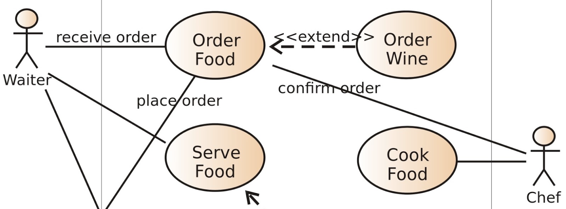
Task Coverage
Important to ensure full coverage of system
Use-cases goals & flows often used as checklist…

Slide 15
But what to watch out for ?

Slide 16
Quantitative & Qualitative
Quantitative aspects of a system
can be measured numerically
Qualitative aspects of a system
are more subtle and subjective
so are harder to measure
A good evaluation considers both !
Each supports the other

Slide 17
Common Quantitive Metrics
Time taken / Time spent achieving task
Number of clicks/taps made
Number of pages/screens visited
Total scrolling distance
Use of "back button“
Use of “undo”
Hesitation (how often and time spent)
Use of help systems (how often and time spent)
Success and failure rates of various steps involved
Success and failure rates of overall task
How would you go about measuring this type of thing?

Slide 18
Qualitative Evaluation
Again, makes use of specific user tasks
But focus now on the “unmeasurable”
(but still identifiable !) through the use of:
Questionnaires
Interviews
Focus groups
User talk-throughs
Now a slide on each of these…

Slide 19
Questionnaires
Paper-based or digital set of predefined questions
An obvious approach – but easily done badly !
Designing good questions is hard
(As we shall see later)
Various design choices to be made…
“Specific questions” versus “Open-ended”
“Free text” versus “Likert scale”
Strongly Agree Agree Not sure either way Disagree Strongly Disagree

Slide 20
Interviews
Face-to-face discussion on experience of tasks
Skill of interviewer is crucial to success of activity
Again, designing good questions is often non-trivial
Again, various design choices to be made…
“Pre-scripted” versus “Open-ended”
Often hybrid with at least one warm-up question

Slide 21
Focus Groups
Group of users talking with a “facilitator”
Less intimidating for users - shift balance of power
More efficient (in terms of time spent talking)
More opportunity for discussion
Individual perspective can sometimes become lost
Shares many issues with interviews including…
Skill of leader, good questions, open-end etc.

Slide 22
User Talk-Throughs
A problem with the previous approaches is that they happen after the task has been completed
Users might have forgotten important details !
A good alternative is therefor the “talk-through”
User explains what he/she is doing as they do it:
What they are thinking
What they understand/misunderstand
What they are intending
What things are working well
What problems they are encountering

Slide 23
Talk-Through: pros and cons
Advantages
You can see “inside people’s heads”
Link feedback directly to what is on the screen
Can uncover issues we hadn’t even anticipate
(so couldn’t have asked a question about)
Disadvantages
Talking aloud about tasks is an unfamiliar activity
Users don’t have time to reflect (unlike interviews)
Talking interferes with the interactive experience !

Slide 24
Skype Talk-Through
Useful approach to remote usability evaluation
Makes use of Skype screen sharing
Remote user is given a task to complete
Works through it step by step
Talking aloud what they are doing
Two streams (audio & video) observed remotely
Can also be recorded…
For transcription / analysis at a later date

Slide 25
Which should you use ?
It all depends upon the nature of your project…
The type of system being built
The type of interaction you are studying
Your level of access to your client
Availability of “good” users
(quality, co-location etc)
Also consider pragmatic issues:
How much time have you got ?
What is the most cost-effective activity in that time

Slide 26
Time to think
Have a think about which approaches to use
Any questions about what you have seen today ?

